Slide 2
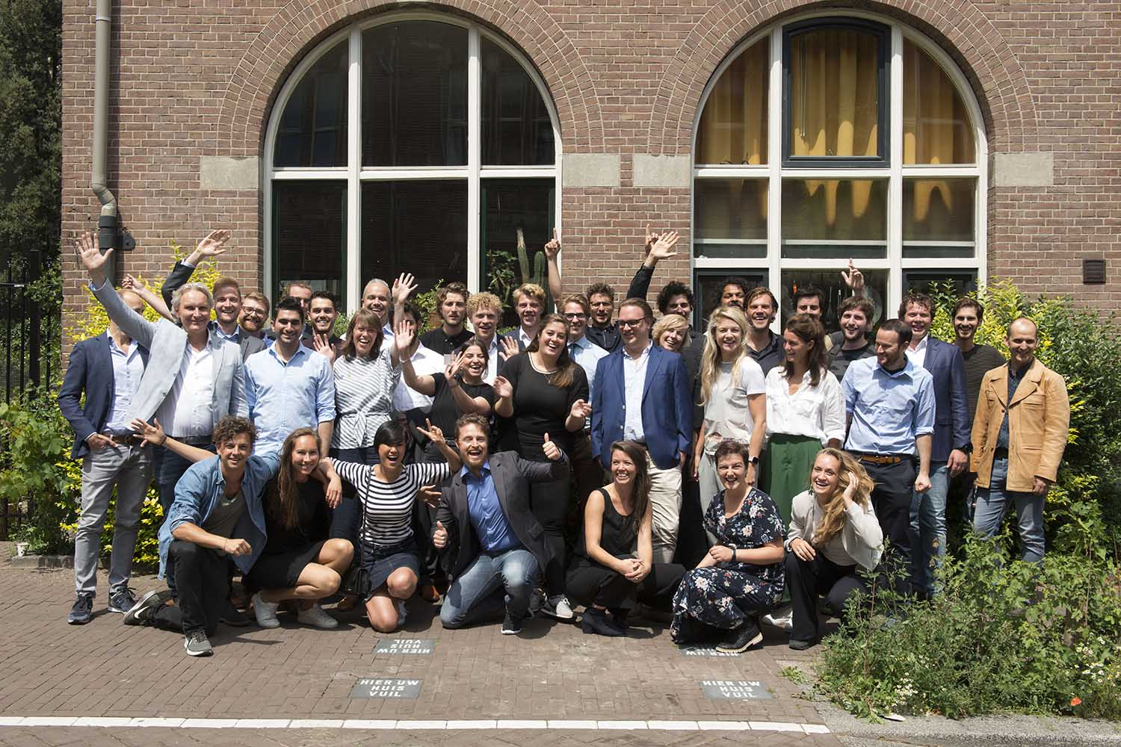
  Startup in Residence is a programme to make the procurement process more accessible to small parties and boost the startup ecosystem.
  Since 2015 in Amsterdam
  20 programmes in NL

Slide 3
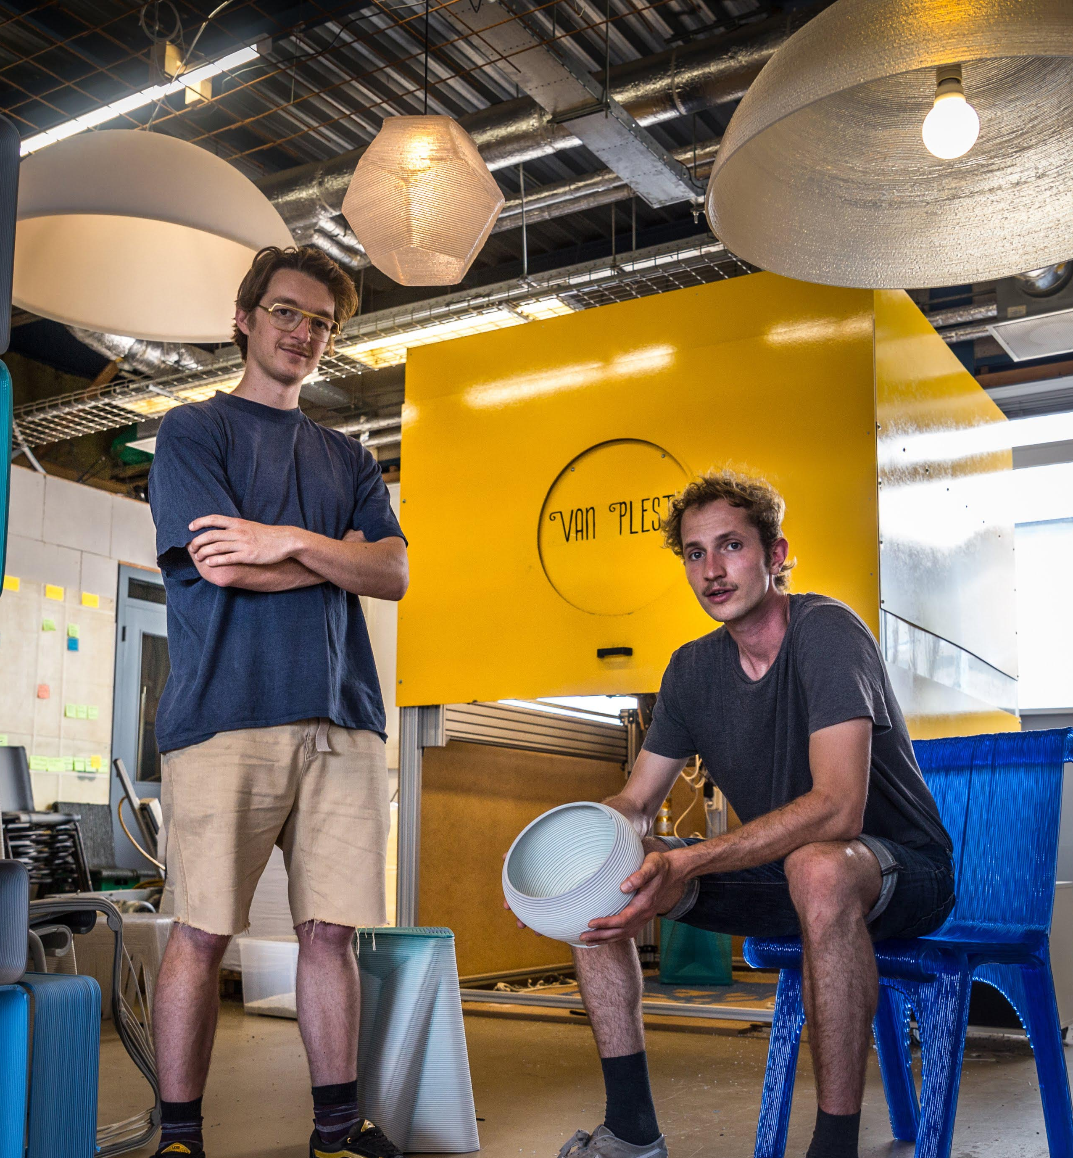
How does SIR work?
  6 month incubator programme
  Innovative trainings and sessions
  Civil servants bring in key social challenges
  Startups work to solve these in a pilot
  Municipality may be the launching customer
  European tender work done upfront
Notes:
Looking outside the municipality for solutions
Buying innovative products/services
Innovative procurement methods
Stimulating the startup ecosystem

Slide 4
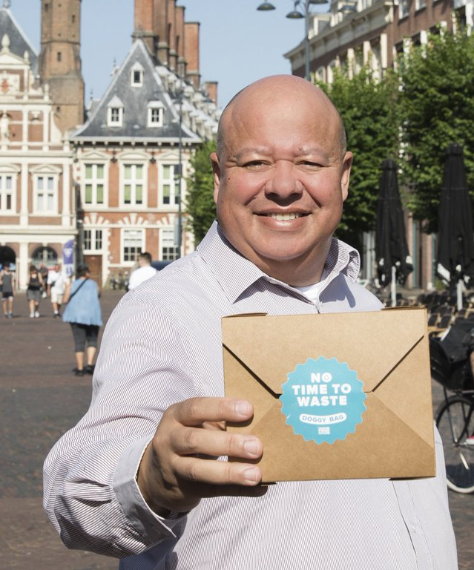
3 reasons to try SIR
  Find smarter solutions to improve the lives of those in your community
  Facilitate creative exchange between civil servants and young companies
  Stimulate innovation and the start-up ecosystem in your community
Through SIR, we were able to tackle food waste in our municipality in a way we would have never been able to do ourselves. And working with a startup changed the way I, and my team, work. - Civil Servant Haarlem

Slide 5
What’s needed to run SIR?
Team to run the programme – at least 1 programme lead
Challenge Owners – civil servants in your area who have problems they’d like to work on with a startup. They have a budget to run a pilot, time to participate in the programme and support from their department or area.
Time to set it up – typically 3 – 6 months
Base budget for events, trainings, marketing, etc.

Slide 6

The heart of SIR: the European tender
Why?
Efficient - Tender work is done up front so proven pilots can scale seamlessly into long-term contracts
Long Term - Up to 5 years collaboration (if specified in the tender)
Large Selection Pool - Any international startups can apply from your country or from anywhere in Europe.

Slide 7
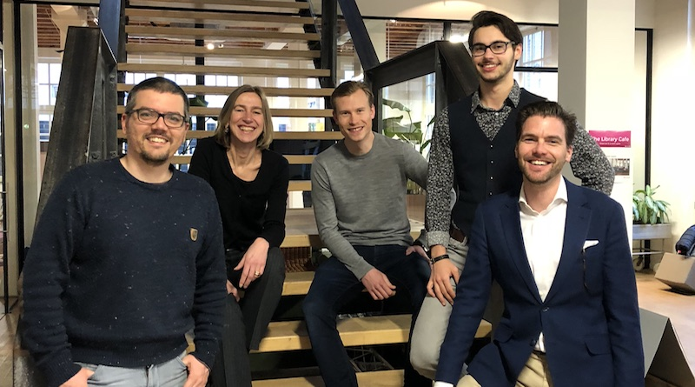

SIR impact
SIR innovates the way civil servants work.
Civil servants say through SIR they
  Have become more user centric
  Are working faster, using iterations
  Are experimenting with solutions, instead of going down one path
  In Amsterdam, more than half of SIR startups sign long-term contracts and implement their solutions
  (a huge success rate for an incubator)
SIR Sustainability Amsterdam in 2019
Developed an online tool that helps buyers check how circular and sustainable potential suppliers are.
Now has a contract with the Amsterdam procurement department, and an additional investment from the Innovatiefonds Noord Holland.

Slide 8
