Slide 1
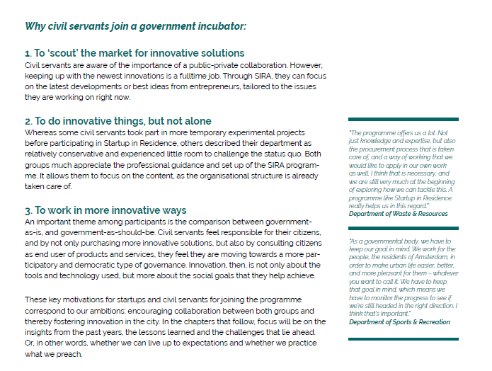
Source: Impact Report SIR 2019

